Slide 1
Lecture Notes on
Coal Mine Water Management

Slide 2



Slide 3
On Completition of Jharia Reconstruction Scheme
Sl.No
Useable areas
Available
1.
Underground Mine pumping
61.00 Mgd
2.
Domestic Water demand
49.50 Mgd
3.
Industrial Water Demand
34.00 Mgd
Total Demand comes to : 83.50 Mgd
Availability would be : 61.00 Mgd

Slide 4
Classification of Mine Waters
 |  | Category of the Minewaters
 |  | A-1 | A-2 | A-3
Water Quality Factor
a. | pH | 7.5-8.5 | 7.0-8.5 | 6.0-8.0
b. | Alkalinity (mg/l CaCO₃) | 200-7000 | 100-500 | 10-30
c. | Hardness (mg/l CaCO₃) | 50-150 | 200-1500 | 1000-2000
d. | Total Dissolved Solids (mg/l) | 300-700 | 500-1500 | 1500-2500
e. | Total Suspended Solids (mg/l) | 5-30 | 12-50 | 10-50
Bio-Chemical Parameters
a. | DO | 5.5-8.0 | 5.0-8.0 | 5.0-8.0
b. | BOD | <1 | <1-2 | <1-2
c. | COD | 8-30 | 15-50 | 15-60
Element or Ion Content
a. | Calcium (mg/l) | 10-50 | 50-200 | 100-150
b. | Magnesium (mg/l) | 10-30 | 40-180 | 80-100
c. | Total Iron (mg/l) | 0-2 | 0-5 | 0-5
d. | Sulphate (mg/l) | 10-100 | 100-800 | 1000 and above
e. | Chloride (mg/l) | 18-40 | 22-45 | 80-400
f. | Bacteriological Contamination Coliform Organisms (MPN/100 ml) | 0-180 | 6-180 | 0-18

Slide 5
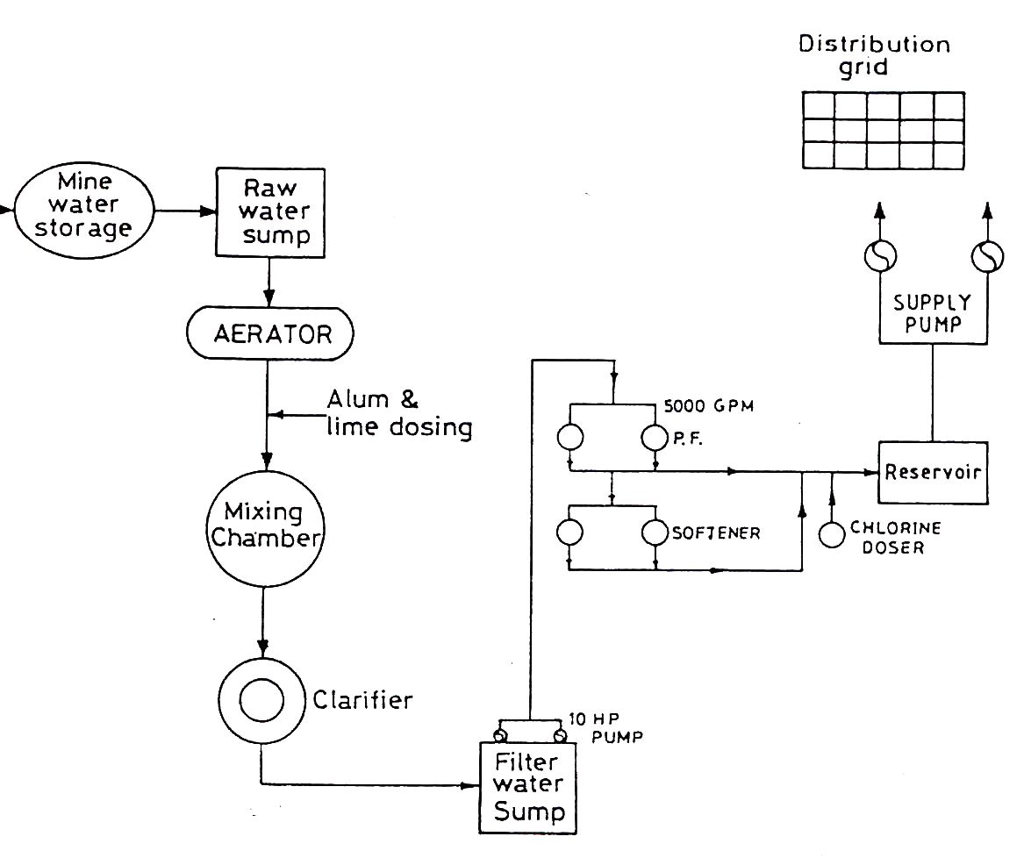
Schematic Layout of Water Treatment Plant in Practice at some of the Mine Sites

Slide 6
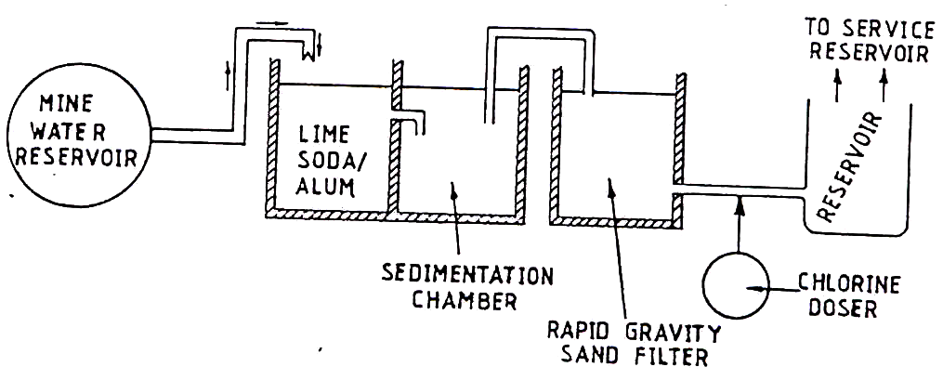
Proposed Low Cost Traeatment Scheme

Slide 7
CAUSES AND OCCURENCES OF
ACID MINE DRAINAGE
PRESENTED BY:
PARAG KHUJNARE
M.TECH.I(E.S.E.)
AD. NO. 612898

Slide 8
WHAT IS AMD ?
Low in pH 2-5
Red muddy Colour
Highly rich in metal and SO₄ content

Slide 9
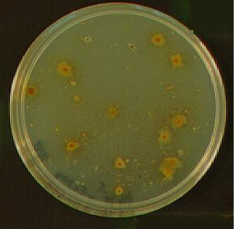
THE BIOLOGY
Presence of Pyrite in Coal
Role of bacteria
Thiobacillus ferroxidans

Slide 10
The Chemistry
The initial step
2 FeS₂ + 7 0₂ + 2 H₂O 2 Fe²⁺ + 4 SO₄ + 4 H⁺
“Rate determining" step
4 Fe ²⁺ + O₂ + 4 H⁺ 4 Fe³⁺ + 2 H₂O
Hydrolysis of ferric iron
4 Fe³⁺ + 12 H₂O 4 Fe(OH)₃ + 12 H⁺
Cyclic propagation of acid generation
FeS₂ + 14 Fe³⁺+ 8 H₂O 15 Fe²⁺ +2 SO₄²⁻ + 16 H⁺

Slide 11
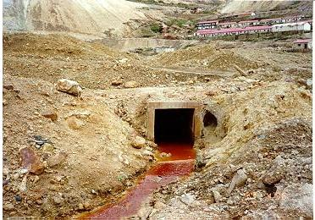

Slide 12
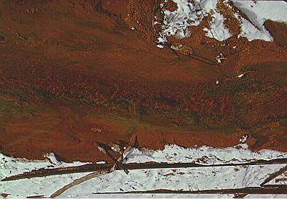

Slide 13
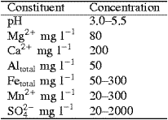
Typical composition of AMD from a coal mine

Slide 14
Parameters | Seepage from Abondoned Uranium Mine tailings Pond in Ontario | Waste Rock Dump seepage from Active Silver Mine in British Colombia | Mine water from underground Coper Mine in British Colombia
pH | 2 | 2.8 | 3.5
Sulphate | 7440 | 7650 | 1500
Acidity | 14600 | 43000 | -
Iron | 3200 | 1190 | 10.6
Mn | 5.6 | 78.3 | 6.4
Cu | 3.6 | 89.8 | 16.5
Al | 588 | 359 | -
Pb | 0.67 | 2 | 0.1
Cd | 0.05 | 0.5 | 0.143
Zn | 11.4 | 53.2 | 28.5
As | 0.74 | 25 | 0.05
Ni | 3.2 | 8.0 | 0.06

Slide 15
Why Is AMD Harmful?
Effects on environment
Effects on living beings
Effects on property

Slide 16
Effects on Environment
Groundwater contamination.
Lower pH of s/f waterbodies.
Deposition of “yellow boy” in waterbodies.
High metal concentrations.

Slide 17
Effects on Living Beings
Harm due to drinking acidic water.
Killing of aquatic life.
Disruption in growth and reproduction of plant and animal life.
Causes skin problems.

Slide 18
Effects on Property
Highly corrosive.
Erodes culverts, bridges, pipes, pipes, pumps, dams, boats, etc.

Slide 19
Treatment of AMD
Passive Methods
    manmade dams or reed beds
    Aerobic wetlands,
    compost wetlands and
    anoxic limestone drains
Active Methods
    Limestone neutralization, ion exchange, liquid membrane extraction, reverse osmosis, solvent extraction and biological treatment
In-situ Treatment
    Alkaline Injection Technology

Slide 20
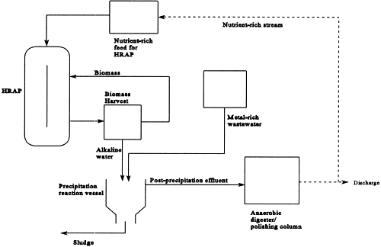
INTEGRATED METAL AND SULPHATE REMOVAL PROCESS FOR THE TREATMENT OF ACID MINE DRAINAGE
alga Spirulina sp.

Slide 21
ACTIVE BIOLOGICAL TREATMENT OF AMD
Consists of three main sub-processes.
First, sulphate-reducing bacteria (SRB) convert the sulphate content of the wastewater to sulphide, using organic compounds such as acetate, lactate, propionate, butyrate, ethanol or a combination of hydrogen and CO₂ as carbon and energy source.
Secondly, the sulphide so produced reacts with metal ions, if present, and precipitates as metal sulphides, which could be processed for the recovery of value metals.
In the absence of sufficient metal ions a further step for treatment of excess sulphide is required. This is achieved using sulphide-oxidizing bacteria (SOB), which utilize oxygen or nitrate as an electron acceptor for oxidation of sulphide to elemental sulphur.

Slide 22
ALKALINE INJECTION TECHNOLOGY – IN-SITU TREATMENT
The treatment involves creation of a highly alkaline buffering zone inside the mine by introducing the CCBs at strategic locations.
The buffered region neutralise the acidic mine water prior to its discharge
The Injection results increase the pH, and impart alkalinity.
At elevated pH levels, metal species would precipitate inside the mine as hydroxides and carbonates compounds

Slide 23
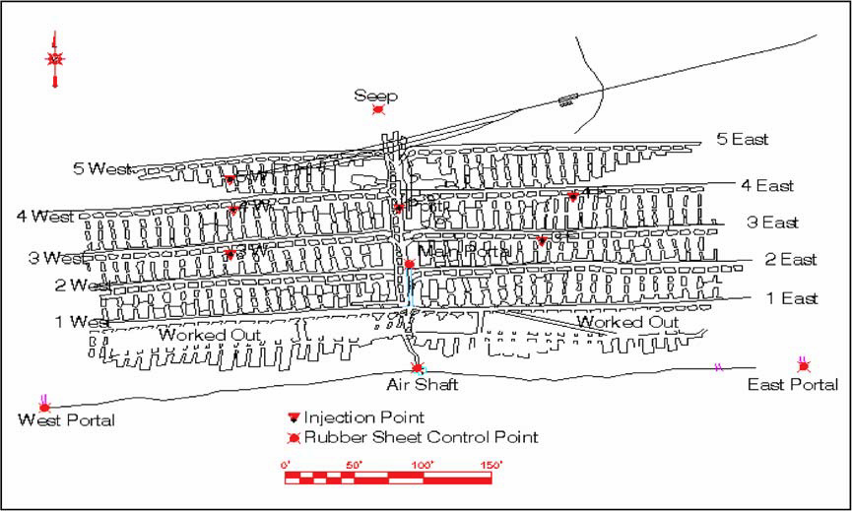

Slide 24
Prevention and Mitigation of AMD
Waste segregation and blending
Base additives
Covers and caps
Bacteriocides
Submergence
Alkaline addition
Water management

Slide 25
Coal Washery
Zero Discharge concepts are being maintained and no effluent is being discharged in surface water body outside the plant boundary.
Industries have state of art-type closed loop zero discharge washeries where the effluent generated are treated with the recovery of coal fines and reuse of treated effluent for coal washing.

Slide 26
Process Flow Chart of Coal washery
R.O.M (450 mm)
Crushing (125 mm)
Screening
Coal Washing
Floatation/Conditioning
Coke Washery effluent
Dewatering/ centrifuging
Centrifuge
Clean coal

Slide 27
Processes involved in Coal washery
RMO: Run off mine. The coal delivered from the mine that reached to the coal preparation plant is known as RMO. RMO is the raw material of coal preparation plant
Crushing; The process of crushing the ROM to 125 mm size
Screening is the process of removing unwanted rock/inorganic impurities from run-of- mine coal.
Coal washing: The fine coal is mixed with water and passes through a heavy media cyclone (H.M. Cyclone) which wash the coal
Floatation: The coal is conditioned with two reagents comprising diesel oil and fraction of tar oil. It is then treated in flotation cells with controlled aeration to separate concentrate as oil flocs.
Dewatering, centrifuge: The combined clean coals are dewatered in centrifuge.

Slide 28
Characteristics of Coal washery effluent
Sl. No | Parameters | Value
1. | Flow (m³/tone of coal) | 0.18
2. | Total solids (mg/l) | 1000-25000
3 | Hardness (mg/l) | 230
4 | Alkalinity (mg/l) | 86
5 | Chlorides (mg/l) | 13
6 | pH | 7.4-7.8
7 | Oil and grease (mg/l) | 9-12
8 | COD (mg/l) | 350-800
9 | DO (mg/l) | 2-3.5

Slide 29
Effluent discharge standard of coal washery
Sr. No. | Parameter | Limits
1 | pH | 5.5-9.0
2 | Total suspended solids | 100 mg/l
3 | Oil & Grease | 10 mg/l
4 | B.O.D. (3 days 27 deg C) | 30 mg/l
5 | COD | 250 mg/l
6 | Phenolics | 1.0 mg/l

